Slide 1
Battle of neighborhood Singapore

Slide 2
Problem Statement:
Prospects of a Lunch Restaurant, Singapore.

Slide 3
Target Audience
Business personnel who want to invest or open a restaurant.
Freelancer who loves to have their own restaurant as a side business.
New graduates, to find reasonable lunch/breakfast place close to office.
Budding Data Scientists, who want to implement some of the most used Exploratory Data Analysis techniques to obtain necessary data, analyze it, and, finally be able to tell a story out of it.

Slide 4
Data Acquisition And Cleaning
Data is acquired from Wiki Page Planning_Areas_of_Singapore to scrap the table to create a data-frame using requests and Beautifulsoup4 library
Getting Coordinates of Areas : Geopy Client
Cleaning The Data :for wrong coordinates of Areas in Singapore. Cleaned data have 55 areas of Singapore
Using Foursquare Location Data

Slide 5
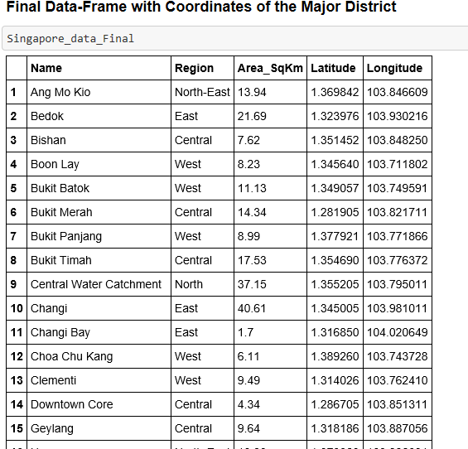
Screenshot of Final Dataframe

Slide 6
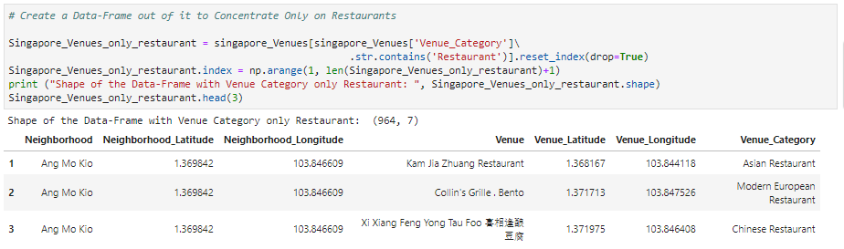
Visualization and Data Exploration
Folium Library and Leaflet Map:
Folium is a python library that can create interactive leaflet map using coordinate data
Only Restaurants are considered from all the venue category. A snippshot of code is shown below

Slide 7
Exploratory Data Analysis
There are 59 unique venue categories and Chinese Restaurants top the charts as we can see in the plot.

Slide 8
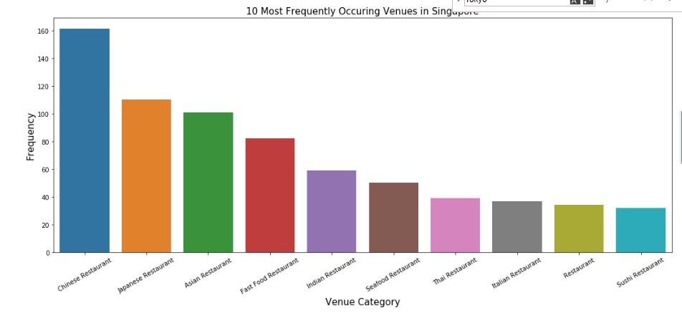

Slide 9
Clustering the Districts
Cluster the Areas based on the venue categories and use K-Means clustering. So our expectation would be based on the similarities of venue categories, these Areas will be clustered.

Slide 10
Results and Discussion:
Chinese restaurants top the charts of most common venues in Singapore.
Geylang (Central region) and Novena (Central region) are dominated by restaurants as the most common venue.

